Slide 1
Deep Learning
Supervised by Prof. Ahmed ElTrass

Slide 2
Machine Learning vs Deep Learning
Enables machine to take decisions on their own based on past data
Small amount of training data
Works well on low-end systems (hardware)
Features needed to be identified in advance manually.
Longer testing.
Problem divided and individually solved.
Needs structured data
Automated feature extraction.
Enables the use of large data sets.
Higher Amounts of training data
Needs powerful computation devices
No human intervention
Shorter testing time.
Problem solved in an end-to-end manner.
Unstructured data

Slide 3
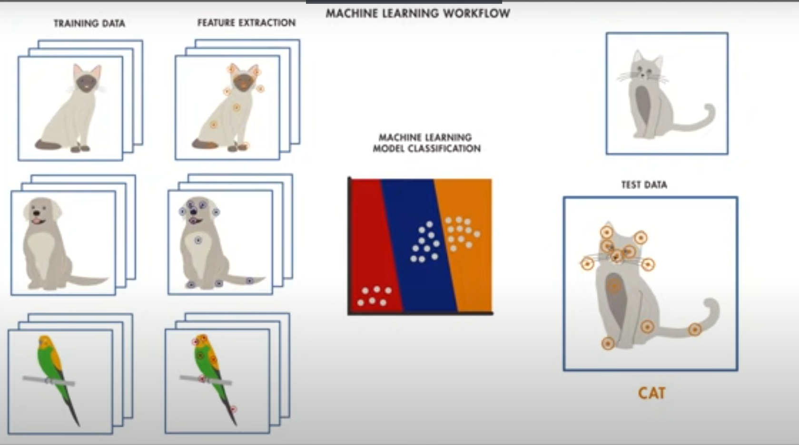
Machine Learning Workflow

Slide 4
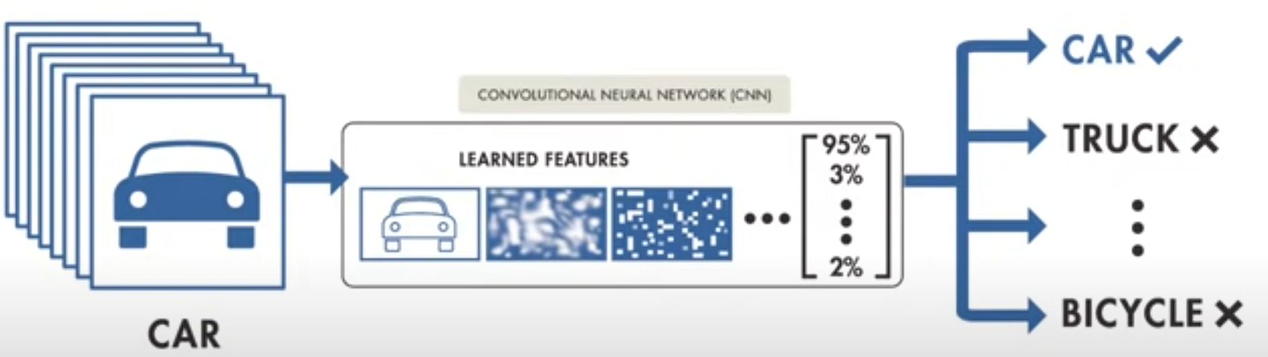
Deep Learning Workflow

Slide 5
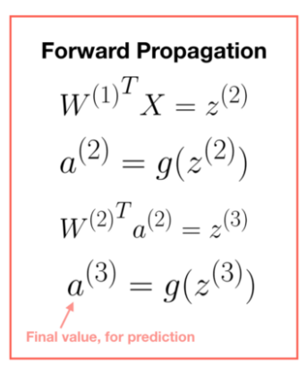
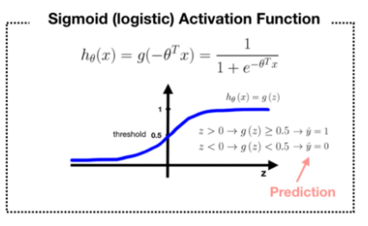
What is a Neural Network NN ?
Single neuron == linear regression without applying activation
A single neuron will calculate weighted sum of input(W.T*X) and then we can set a threshold to predict output in a perceptron. If weighted sum of input cross the threshold, perceptron fires and if not then perceptron doesn’t predict.
Neuron can take real values input or Boolean values.
Disadvantage of neuron is that it only output binary values and if we try to give small change in weight and bias then perceptron can flip the output. We need some system which can modify the output slightly according to small change in weight and bias. Here comes sigmoid function in picture.
If we change neuron with a sigmoid function, then we can make slight change in output

Slide 6
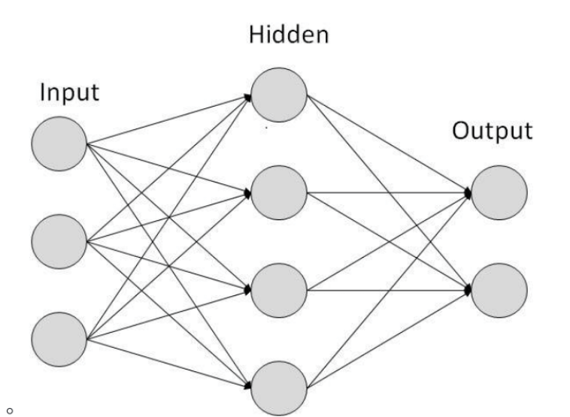
e.g. output in neuron = 0, you slightly changed weight and bias, output becomes = 1 but actual output is 0.7. In case of sigmoid, output1 = 0, slight change in weight and bias, output = 0.7.
If we apply sigmoid activation function then Single neuron will act as Logistic Regression.
we can understand difference between perceptron and sigmoid function by looking at sigmoid function graph.
Simple NN graph (2 layer)

Slide 7
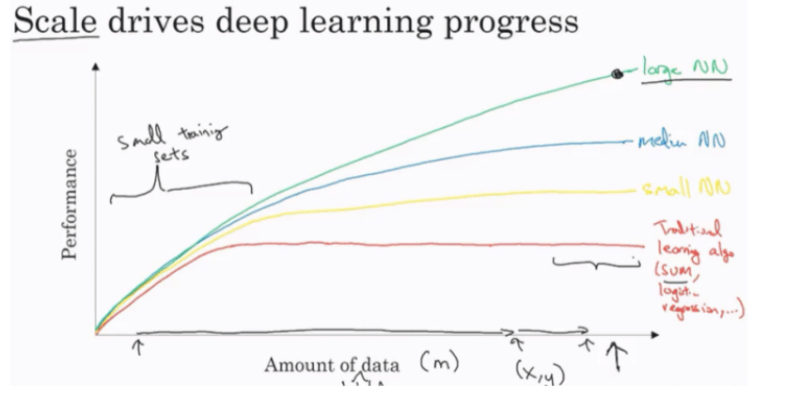
Why is Deep Learning is taking off ?
Data:
For small data NN can perform as Linear regression or SVM (Support vector machine)
For big data a small NN is better that SVM
For big data a big NN is better that a medium NN is better that small NN.
we have a lot of data because the world is using the computer a little bit more: Mobiles, IOT (Internet of things)
Computation: GPUs, Powerful CPUs, Distributed computing, ASIC
Algorithm:
Creative algorithms has appeared that changed the way NN works. e.g. RELU is better than SIGMOID in training a NN (helps with the vanishing gradient problem).

Slide 8
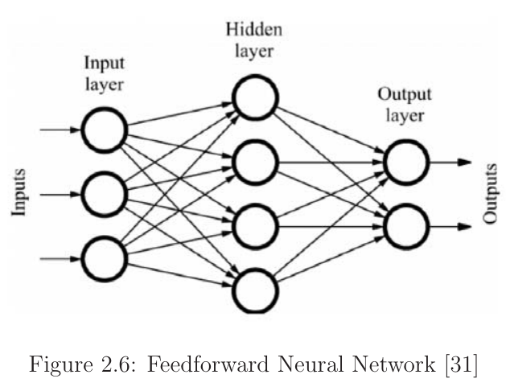
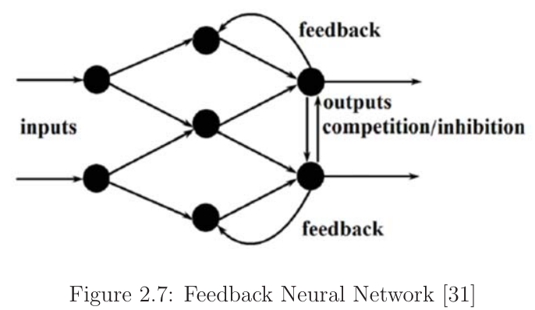
Common types of ANN
Feedforward
Signals travel in one way i.e. from input to output only in Feed forward. Neural Network. There is no feedback or loops. The output of any layer does not affect that same layer in such networks.
Feedback Networks
Signals can travel in both the directions in Feedback neural networks. Feed-back neural networks are very powerful and can get very complicated. Feed-back neural networks are dynamic. The state in such network keep changing until they reach an equilibrium point. They remain at the equilibrium point until the input changes and a new equilibrium needs to be found. Feedback neural network architecture is also referred to as interactive or recurrent, al- though the latter term is often used to denote feedback connections in single-layer organizations. Feedback loops are allowed in such networks. They are used in content addressable memories.

Slide 9
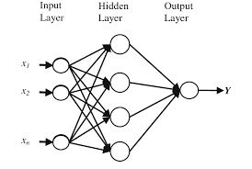
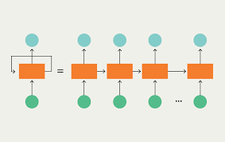
Types of Artificial Neural Networks
Radial basis Function NN (RBFNN):
Recurrent Neural Network (RNN):

Slide 10
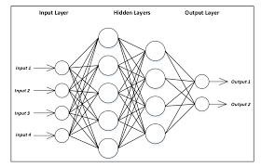
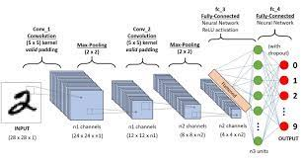
Multilayer Perceptron (MLP):
Convolutional Neural Network (CNN):

Slide 11
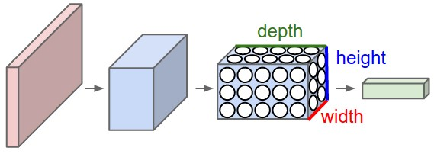
CONVOLUTION NEURAL NETWORK(CNN)
Convolutional Neural Networks (CNNs / ConvNets):
Convolutional Neural Networks are very similar to ordinary Neural Networks from the previous chapter: they are made up of neurons that have learnable weights and biases. Each neuron receives some inputs, performs a dot product and optionally follows it with a non-linearity. The whole network still expresses a single differentiable score function: from the raw image pixels on one end to class scores at the other. And they still have a loss function on the last (fully-connected) layer and all the tips/tricks we developed for learning regular Neural Networks still apply.
So what changes? ConvNet architectures make the explicit assumption that the inputs are images, which allows us to encode certain properties into the architecture. These then make the forward function more efficient to implement and vastly reduce the amount of parameters in the network.

Slide 12
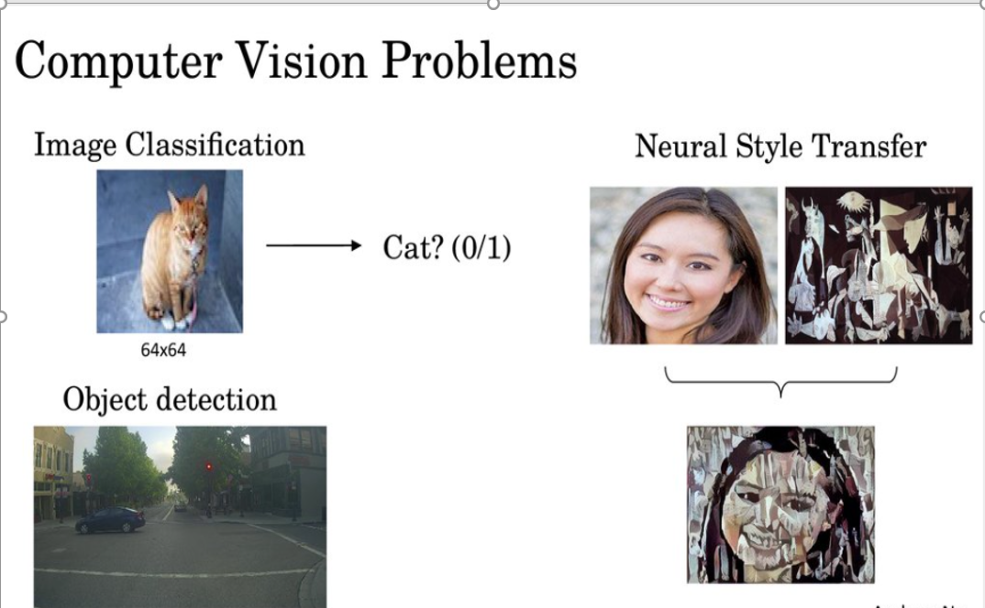

Slide 13
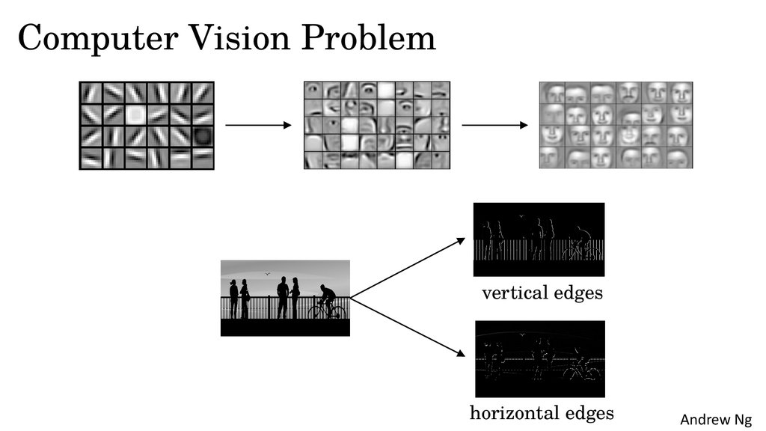
?

Slide 14
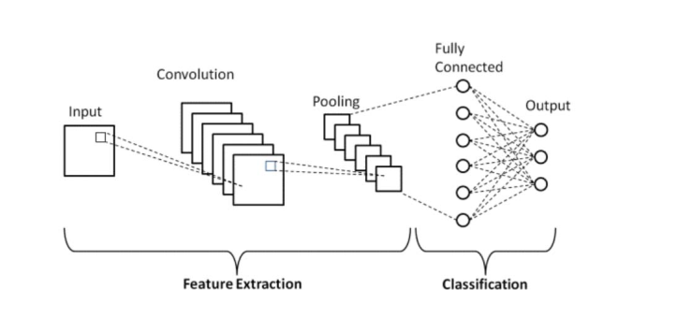
CNN ARCHITECTURE
The CNN architecture can be divided into two main parts:
• A convolution tool that separates and identifies the various features of the image for analysis in a process called as Feature Extraction. • A fully connected layer that utilizes the output from the convolution process and predicts the class of the image based on the features extracted in previous stages.
Neural Networks in general are composed of a collection of neurons that are organized in layers, each with their own learnable weights and biases. The basic building blocks of a CNN are:
• A tensor can be thought of as an n-dimensional matrix. • A neuron can be thought of as a function that takes in multiple inputs and yields a single output. • A layer is simply a collection of neurons with the same operation, including the same hyperparameters. CNNs utilize a special type of layer , aptly named a convolutional layer, that makes them well-positioned to learn from image and image-like data. Regarding image data, CNNs can be used for many different computer vision tasks, such as image processing, classification, segmentation, and object detection. • Kernel weights and biases, while unique to each neuron, are tuned during the training phase, and allow the classifier to adapt to the problem and dataset provided.

Slide 15
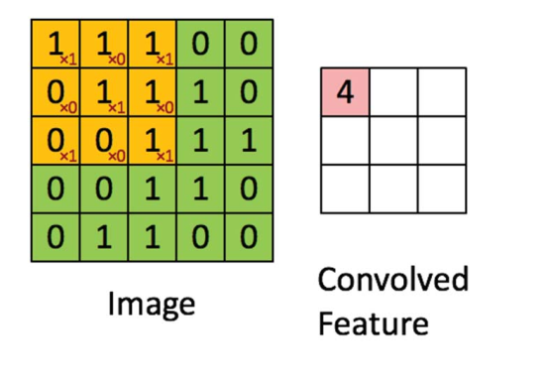
CNN Layers
Convolution layer: This layer is the first layer that is used to extract the various features from the input images. In this layer, the mathematical operation of convolution is performed between the input image and a filter of a particular size MxM. By sliding the filter (the orange matrix) over the input image(the green matrix), the dot product is taken between the filter and the parts of the input image with respect to the size of the filter (MxM). The output is termed as the Feature map which gives us information about the image such as the corners and edges. Later, this feature map is fed to other layers to learn several other features of the input image.

Slide 16
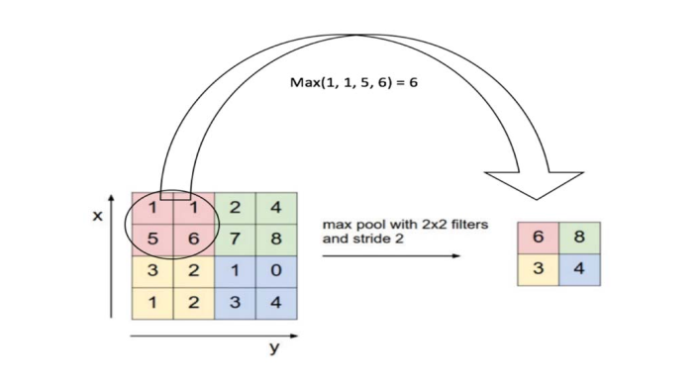
2) Pooling layer
In most cases, a Convolutional Layer is followed by a Pooling Layer. The primary aim of this layer is to decrease the size of the convolved feature map to reduce the computational costs. This is performed by decreasing the connections between layers and independently operates on each feature map. Depending upon method used, there are several types of Pooling operations. In Max Pooling, the largest element is taken from feature map. Average Pooling calculates the average of the elements in a predefined sized Image section. The total sum of the elements in the predefined section is computed in Sum Pooling. The Pooling Layer usually serves as a bridge between the Convolutional Layer and the FC Layer.

Slide 17
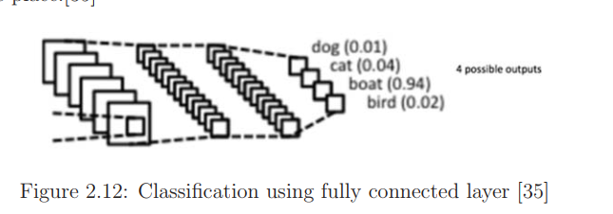
3) Fully Connected Layer The Fully Connected (FC) layer consists of the weights and biases along with the neurons and is used to connect the neurons between two different layers. These layers are usually placed before the output layer and form the last few layers of a CNN Architecture. In this, the input image from the previous layers are flattened and fed to the FC layer. The flattened vector then undergoes few more FC layers where the mathematical functions operations usually take place. In this stage, the classification process begins to take place.
4) Dropout Usually, when all the features are connected to the FC layer, it can cause overfitting in the training dataset. Overfitting occurs when a particular model works so well on the training data causing a negative impact in the models performance when used on a new data.To overcome this problem, a dropout layer is utilised wherein a few neurons are dropped from the neural network during training process resulting in reduced size of the model. On passing a dropout of 0.3, 30 percent of the nodes are dropped out randomly from the neural network.

Slide 18
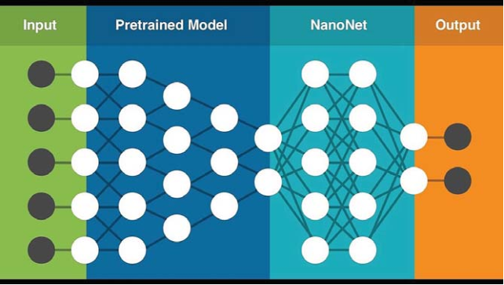
Pre-Trained Models In computer vision, transfer learning is usually expressed through the use of pre-trained models. A pre-trained model is a model that was trained on a large benchmark dataset to solve a problem similar to the one that we want to solve. Accordingly, due to the computational cost of training such models, it is common practice to import and use models from published literature (e.g. VGG, Inception, MobileNet).

Slide 19
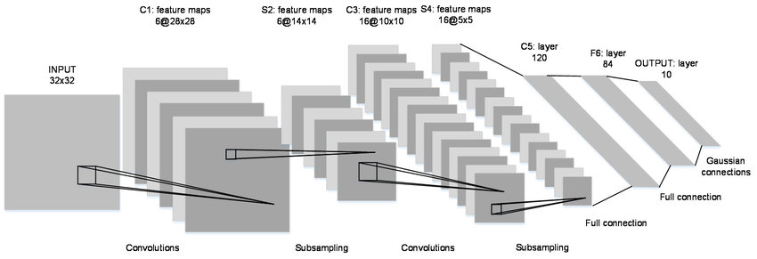
Le-net 5

Slide 20
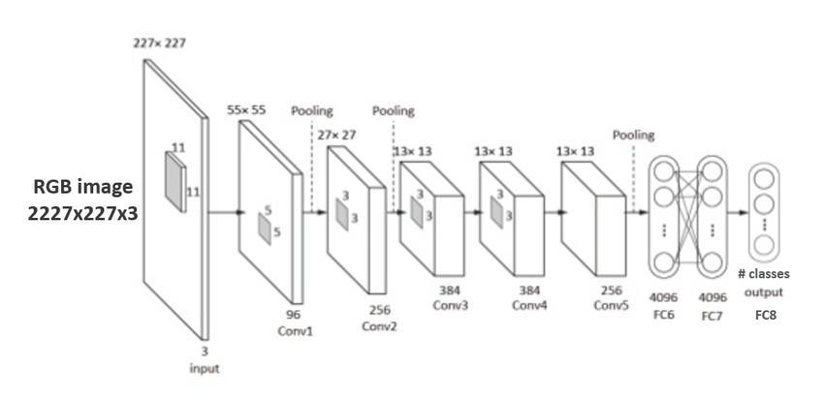
ALEX-NET

Slide 21
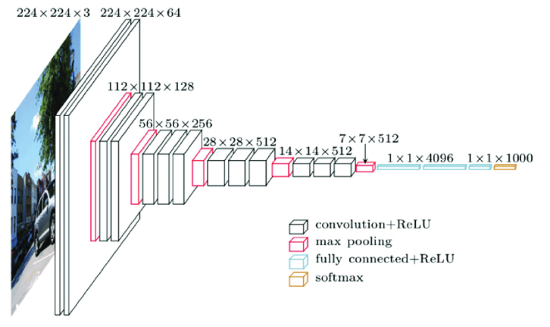
VGG 16
VGG (e.g. VGG16 or VGG19): VGG addresses a very important aspect of CNNs: depth which is shown in its architecture: – Input: VGG takes in a 224x224 pixel RGB image. For the ImageNet competition, the authors cropped out the center 224x224 patch in each image to keep the input image size consistent.
Convolutional Layers: The convolutional layers in VGG use a very small receptive field (3x3, the smallest possible size that still captures left/right and up/down). There are also 1x1 convolution filters which act as a linear transformation of the input, which is followed by a ReLU unit. The convolution stride is fixed to 1 pixel so that the spatial resolution is preserved after convolution.
– Fully-Connected Layers: VGG has three fully-connected layers: the first two have 4096 channels each and the third has 1000 channels, 1 for each class.
– Hidden Layers: All of VGGs hidden layers use ReLU (a huge innovation from AlexNet that cut training time). VGG doesnot generally use Local Response Normalization (LRN), as LRN increases memory consumption and training time with no particular increase in accuracy

Slide 22
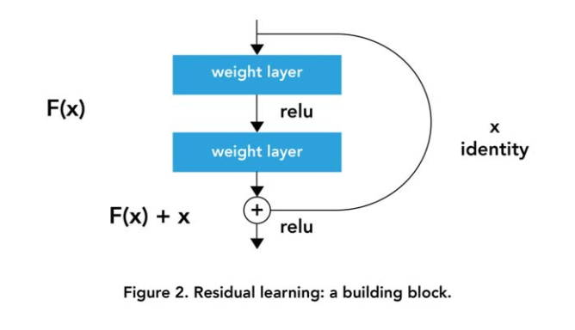
Residual Network (e.g. ResNet50)
The problem of training very deep networks has been alleviated with the introduction of ResNet or residual networks and these Resnets are made up from Residual Blocks. The very first thing we notice to be different is that there is a direct connection which skips some layers(may vary in different models) in between. This connection is called ”skip connection” and is the core of residual blocks. Due to this skip connection, the output of the layer is not the same now.

